Slide 1
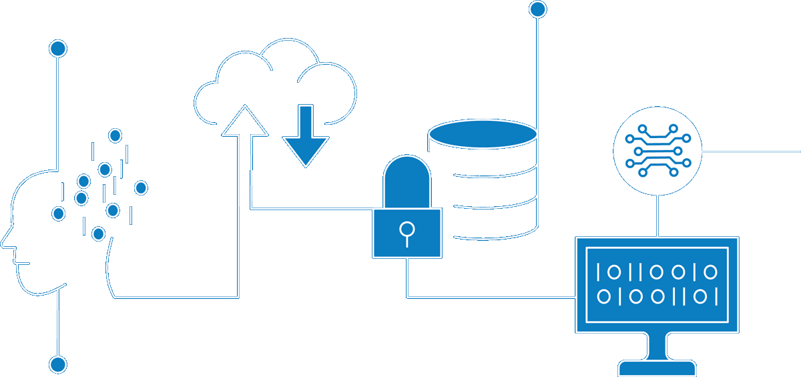
Enterprise Data Platform and US Customer Data Platform
Enterprise Information Architecture

Slide 2
Contents
01 | Enterprise Data Platform
 | Why Enterprise Data Platform? What is Enterprise Data Platform (EDP)? Enterprise Data Platform Capability Pillars Enterprise Data Platform Tools Roadmap Enterprise Data Platform High level Architecture National Grid Data Strategy Master Data Management Roadmap
02 | US Customer Data Platform Overview
 | Customer Data Demand Customer Data Flow – Current State and Challenges Customer Data Transformation Journey US Customer Business Capabilities Proposed Roadmap
Questions

Slide 3
01
Enterprise Data Platform

Slide 4
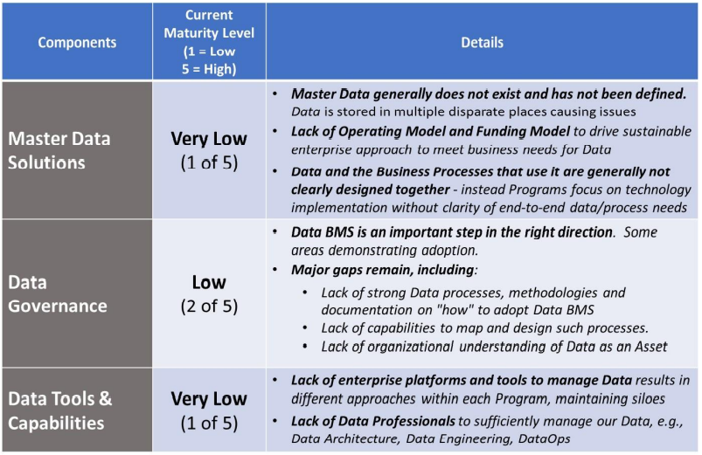
Why Enterprise Data Platform?
As per the “Fixing Data” paper presented in April 2020 to executives by Chief Data Officer Charles Zentay at a time, unless we “Fix Data” our security, major programs, and financial and operational performance are at risk. The paper was based work by Boston Consulting Group BCG). As per the paper National Grid rates “low” or “very low” across the three major components of Data (Master Data Solutions, Data Governance, and Data Tools & Platforms). BCG’s study, that looked into a subset of the Data domains at National Grid, estimated the costs of bad Data are $73-98M. Given the limited scope of their review, they concluded that the full cost is likely much higher.”
To addresses these issues, we need three key components to “Fix Data”:
Data Tools & Capabilities – One, common approach to Enterprise Data solutions
Master Data Solutions – for each data domain, establish a data master
Data Governance & Stewardship – Business ownership of data, accelerated by BMS

Slide 5
What is Enterprise Data Platform (EDP)?
Our EDP is made up of Core Information Processing Capabilities that together provide…
A modern global scalable Infrastructure and capability platform specific to Information from creation thru advanced analytics; from structures to semi-structured to image formats
Allows National Grid to accelerate its Digital journey
Cloud as our primary environment (Azure as primary cloud service)
Support new business needs from Advanced Analytics to streaming IoT data
Purpose built
Trusted
Enable business insight at scale and velocity
Scalable and extensible – throughput and use cases
Hybrid Cloud and On-Premise

Slide 6
Enterprise Data Capabilities Pillars
Data Catalog & Governance
Data Quality
Master Data Management
(MDM)
BI & Self Service Analytics
Data Integration & Orchestration
Cloud Data Platform (CDP)
Data Modeling
ML/AI
Data Science
Idera ER/Studio
Informatica EDC and Axon
Informatica Cloud Data Quality (CDQ)
Matillion / MuleSoft (US/UK) / Striim / GoAnywhere MFT
Reltio
(US/UK)
Snowflake
(US/UK)
Power BI
TBD
Business transformation alignment & enablement
New technology & architecture discovery and enablement – 6 month to 5 year event horizon
Global and regional consulting support at program and project scope

Slide 7
Enterprise Data Platform Tools Roadmap
Research Initiated
Tool(s) Selected
ITGC Approved
Capability available
Expected GA
Actively Deployed
FY2021
FY2022
Q1 | Q2 | Q3 | Q4
Q1 | Q2 | Q3 | Q4
BI & Self Service Analytics – Power BI
Data Modeling - ER/Studio & Team Server
Cloud Data Platform – Snowflake
Master Data Management – Reltio
Data Quality, Data Catalog, Data Governance - Informatica
Data Integration & Orchestration – Matillion
Advanced Analytics, Machine Learning & AI - TBD

Slide 8
Enterprise Data Platform High level Architecture

Slide 9



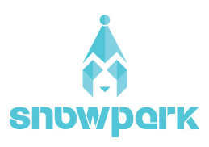







National Grid Data Strategy
Capture
Share
Utilise
Stream
Edge Analytics
Store
Streaming
Continuous
IOT
Quality
Model
Palantir positioning – niche use cases
Batch
Enterprise Analytics
Ingestion
Catalogue
Publish
Embedded
Profile
Privacy / Security
Exploration
Master Data
Innovation Lab
ER/Studio
Under consideration

Slide 10
Master Data Management Proposed Roadmap (Draft)
Tools
2021
2022
Jul
Aug
Sep
Oct
Nov
Dec
Jan
Feb
Mar
April
May
Jun
Jul
Aug
Sep
Oct
Nov
Dec
Reltio
MDM Tool
Contract Signed
MDM DEV Environment
Available (US)
MDM TEST & RPOD
Environments Available (UK)
MDM DEV Environment
Available (UK)
MDM TEST & RPOD
Environments Available (UK)
MVP Release 1C
MVP Release 2C
MVP Release 3C
US Customer
Master Data
Approve
Implementation Funding
Customer
Pre-work
Persistent ID, Key Customer Profile and contact fields, Billing Account
Customer Demographic,
Preference, Premise, Service Account, Meter
Customer, Segments,
Customer Programs/Plans
MVP Release 1W
MVP Release 2W
Global Workforce
Master Data
Workforce
Pre-work
Worker Persistent ID, Key worker fields, Position, Event, Org, hierarchy, Cost Center, Location, Union, Legal Entity, Job, Vendor
Additional Worker Fields
Approve
Implementation Funding
MVP Release 1A
MVP Release 2A
US Asset
Master Data
Approve
Implementation Funding
US Asset/Location Pre-work and POC
Persistent Unique ID, Key Location and Asset fields
Additional Asset and Location Fields
MVP Release 1KA
UK Asset
Master Data
Approve
Implementation Funding
UK Asset/ Location Pre-work and POC
Persistent Unique ID, Key Location and Asset fields
Note:
Please see each project for final scope and confirm MVP release dates
UK Environment is be available only when we have confirmed requirement

Slide 11
02
US Customer Data Platform Overview

Slide 12
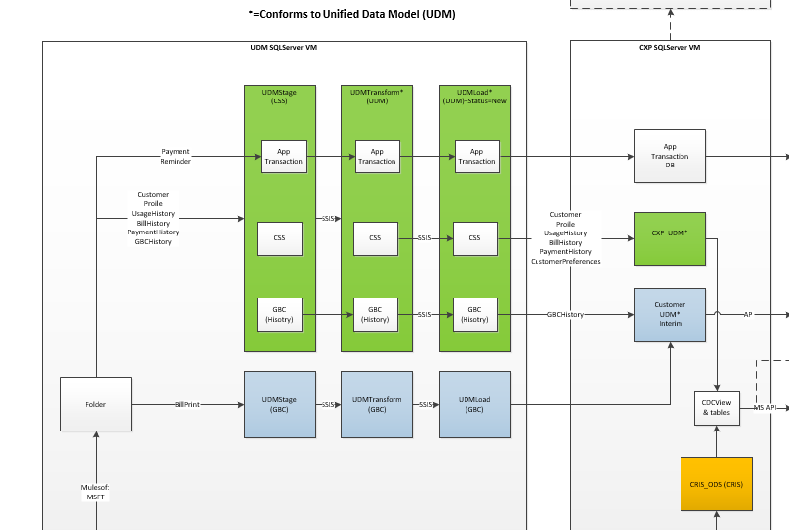
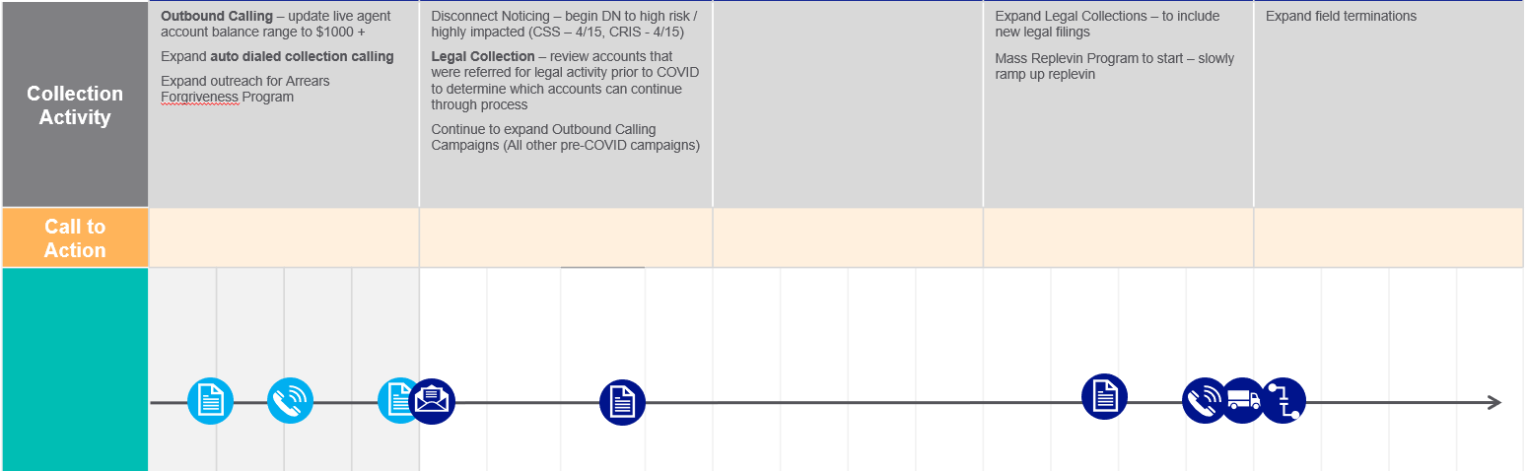
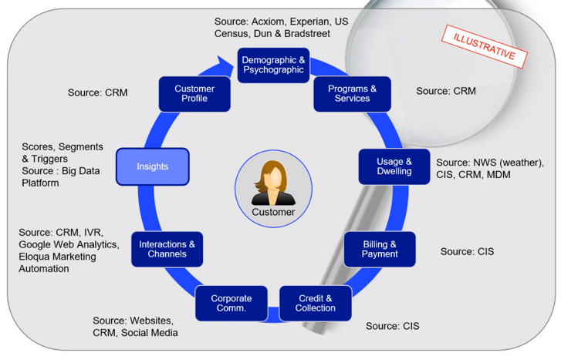
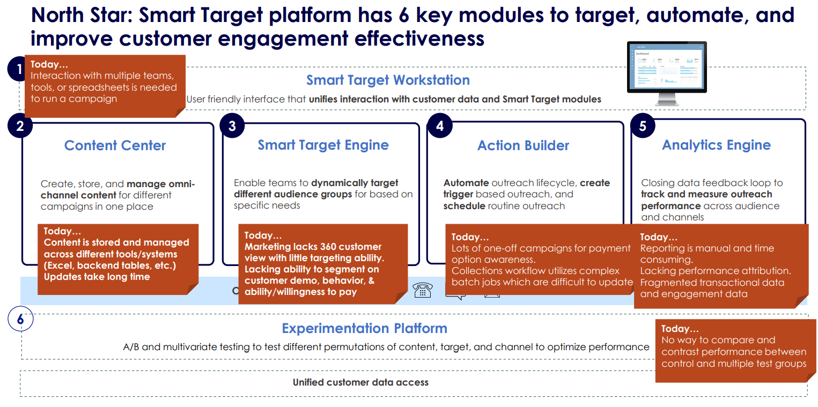
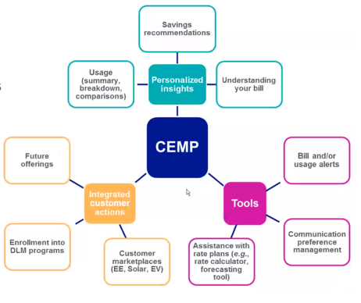
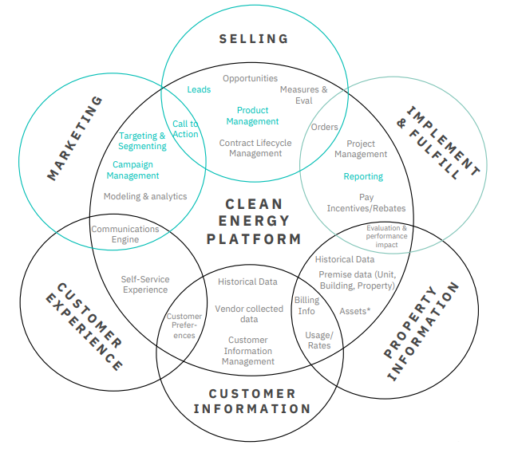
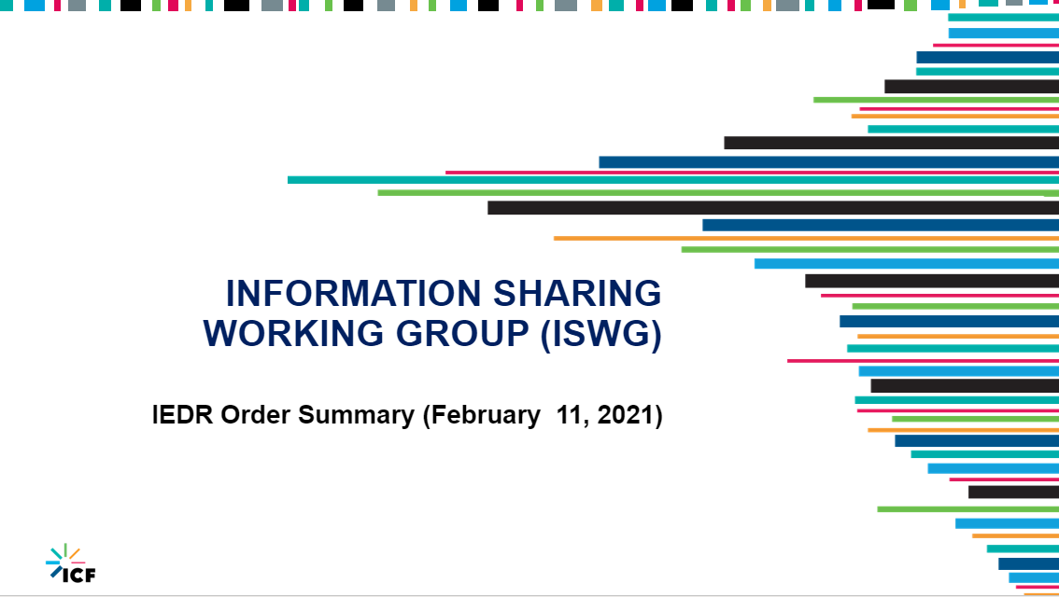
Customer Data Demand Transformational Programs Requiring Customer Data
The demand for secure and timely access to large volumes of quality Customer Data is increasing at an alarming rate. The following are a few examples of both internal and external sources of this demand. We also expect additional data needs to come from the ZBR and CIS Meta Assessment initiatives. However, that demand has not been formalized to date
1
2
3
4
Zero-based Redesign
IVR and Omni-channel reporting and analytics
Unified Web Portal (UWP)/GBE-CE
Credit and Collections
Customer Digital - Smart Target
A digital platform empowering our Customer team to create, target, and optimize customer outreach, and create deeper engagement along the customer journey
Unified Data Model (UDM) – Interim State
Transitional service
Targeting and segmenting customer to improve collections activities
5
AMI / Customer Energy Mgt Platform
6
Clean Energy Blueprint
Clean Energy Strategic outcomes require a Product Catalog, a robust customer segmentation and marketing automation platform with a 360-degree view of the customer and Reporting / Evaluation services. Smart Target and EDP are key foundational enablers of these services.
7
Integrated Energy Data Resource (IEDR)
NYS Order was issued in Feb 2021 requiring the establishment of a comprehensive state-wide database program including the ability to collect, integrate, analyze and manage a wide variety of standardized energy-related Information (e.g. Customer, Asset, weather, demographics, zoning, building attributes, land attributes, property taxes, real estate values, locations of environmental justice areas, EV, DER power quality measurements, etc.). This also includes a Data Access Framework
The AMI Customer Engagement Plan and CEMP Services are heavily dependent on EDP and Third-Party services to provide Customers with Personal insights, tools and services for more effective management of their Energy Usage & Costs
Demand scope is planned for review with the Customer Business Data Lead and PMO

Slide 13
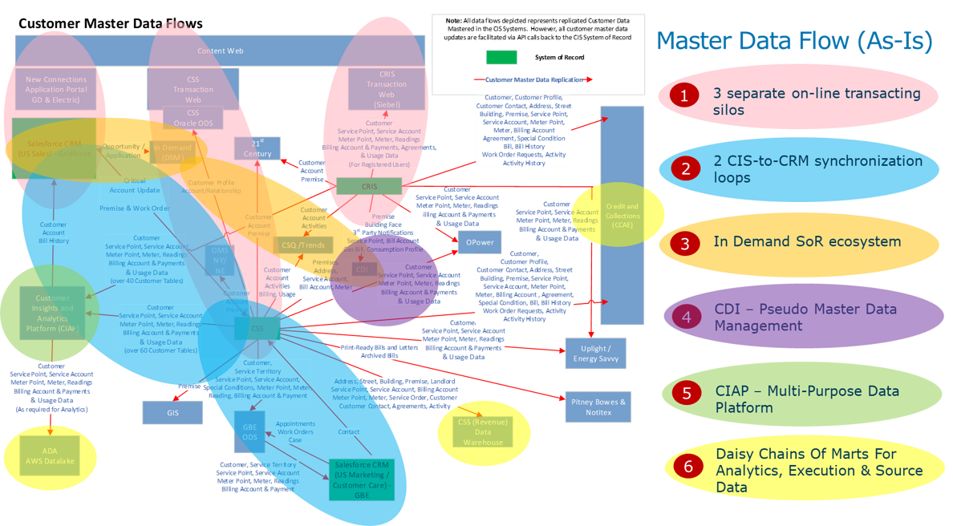
Customer Data Flow – Current State and Challenges

Slide 14
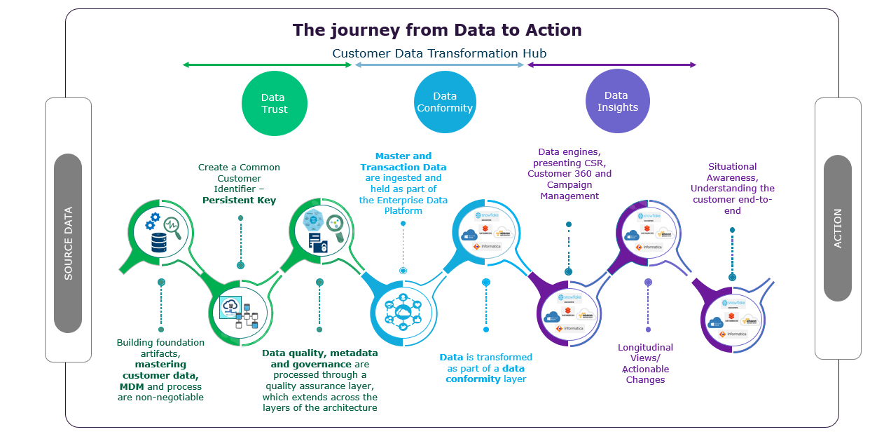
Customer Data Transformation Journey
To achieve the data remediation efforts there must be an integrated foundational framework to exploit value opportunities tied to business outcome
Customer Data Transformation Assessment (CDTA)

Slide 15

US Customer Business Capabilities Proposed Roadmap (Draft)
Delivery / Value Streams:
Data Management Foundational
Customer Data Foundational
Customer Data Integration Services
2021
2022
Releases:
Jul
Aug
Sep
Oct
Nov
Dec
Jan
Feb
Mar
April
May
Jun
Jul
Aug
Sep
Oct
Nov
Dec
MVP R1
MVP R2
MVP R3
MVP R4
Business Capabilities Support
Informatica Catalog, Governance and Quality Tools available
C7 – Product Catalog
C8 – Customer Programs
C1 – Segmentation Campaign Metrics
C3 – Personalized
Messages
C13 – Consolidated Profile (Partial)
C9 – Usage Analysis
C2 – Utilization Recommendation
C4 – Customer
Interactions
Reltio MDM and Matillion Tools available (US)
C14 – Usage Prediction
C5 – Comprehensive Profile
C10 – EE Recommendations
C8 – Customer Programs
C15 –Campaign
Performance Metrics
C11 – Energy Self Service
C12 – Energy Usage Insights
CRIS and CSS CDC (for MVP2)
C17 – EE Ratings
C18 – Personalized Product Guidance
C16 – Loyalty
Program
C20 – Usage History
C19 – Energy Savings and Incentives
C22 – Proactive Usage Feedback
C21 – Enrollment Offers
C23 – Outage Status
C25 – Customer Balance
MDM/DQ/DG
Customer Data model, Data Catalog, Data Governance, Data Quality Profiling, CDC, Business Rules/Requirement
Persistent ID (leverage UDM) , Key Customer Profile and Contact fields, Billing Account
Customer Demographic,
Preference, Premise, Service Account, Meter
Customer, Segments,
Customer Programs/Plans
Data Platform
Data Quality Profiling, CDC, Business Rules/Requirement
Persistent ID (leverage UDM) , Key Customer Profile and Contact fields, Billing Account
Usage, Bill/Credit/Payment, Customer Demographic,
Preference, Premise, Service Account, Meter
Customer Segments,
Customer Program/Plan, Campaign, Campaign Response, IVR
Customer Interaction,
Messages, Addition Customer Data
Notes:
Bottom-up view of enabling Data Capabilities in support of prioritized business capabilities
- Iterative approach to building out capabilities incrementally though data enablement – Clean data available and under management - Master Data managed under MDM and both Master and Transaction Data Available within the Data Hub
Business Capabilities sequencing and timelines are still subject to Top-Down Analysis under the Program Governance & Alignment and Technology Solutioning Towers (taking place over the next 3-4 months, but subject to funding)
- Programs need to re-align priorities and release plan, cross-program gaps and dependencies need to be revisited and programs must be funded and resourced accordingly. This is especially impacted by program gaps in CRM and Automated
Marketing capabilities
- Note: CRM and Marketing Automation Completes in Dec 2022
Timelines for many of the required business capabilities extend beyond May-2022 which are being driving by process and tech changes
Some Capabilities that the Blueprint suggests will be dependent on a step change in platform can begin to be enabled by a Step change in data (e.g. Billing Insights). Other such as (New Service Connect) will obviously be clearly be dependent on AMI service

Slide 16


